Slide 1

Designing rigorous surveys and experiments: RANDOMISATION!!!
Dr John Dwyer CONS7008

Slide 2
Strength of inference
Ability to draw conclusions about our POPULATION of interest from a SAMPLE
Ability to explain observed pattern and rule out alternatives
Requires controls, replication and RANDOMISATION

Slide 3
Randomisation
Two main reasons:
To obtain unbiased samples from a population
E.g. we usually don’t want all males, or all juveniles
Allocate treatments to experimental units

Slide 4
Sampling from populations
The sample must be representative of the population of interest
Samples must be a large enough to make strong inferences

Slide 5
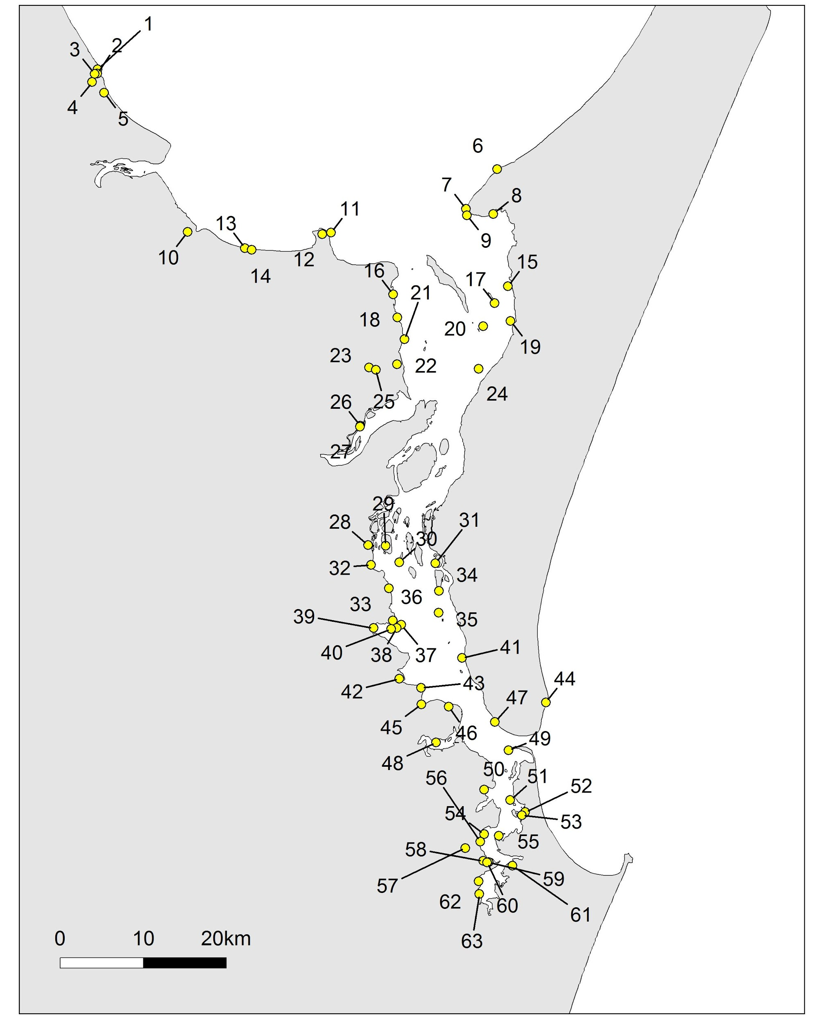
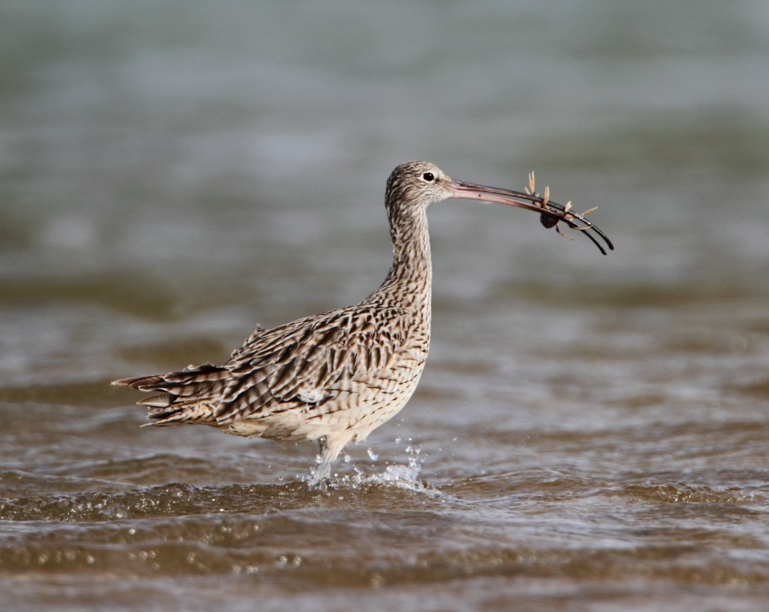
In this a representative sample?

Slide 6
Another sampling scenario
A polling company randomly calls mobile phones to ask about voting intentions.
What population is intended to be sampled?
What population has been sampled?

Slide 7
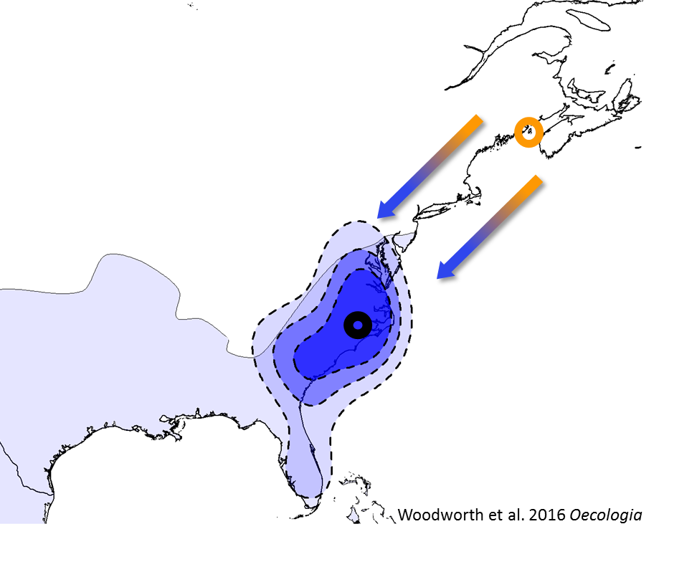
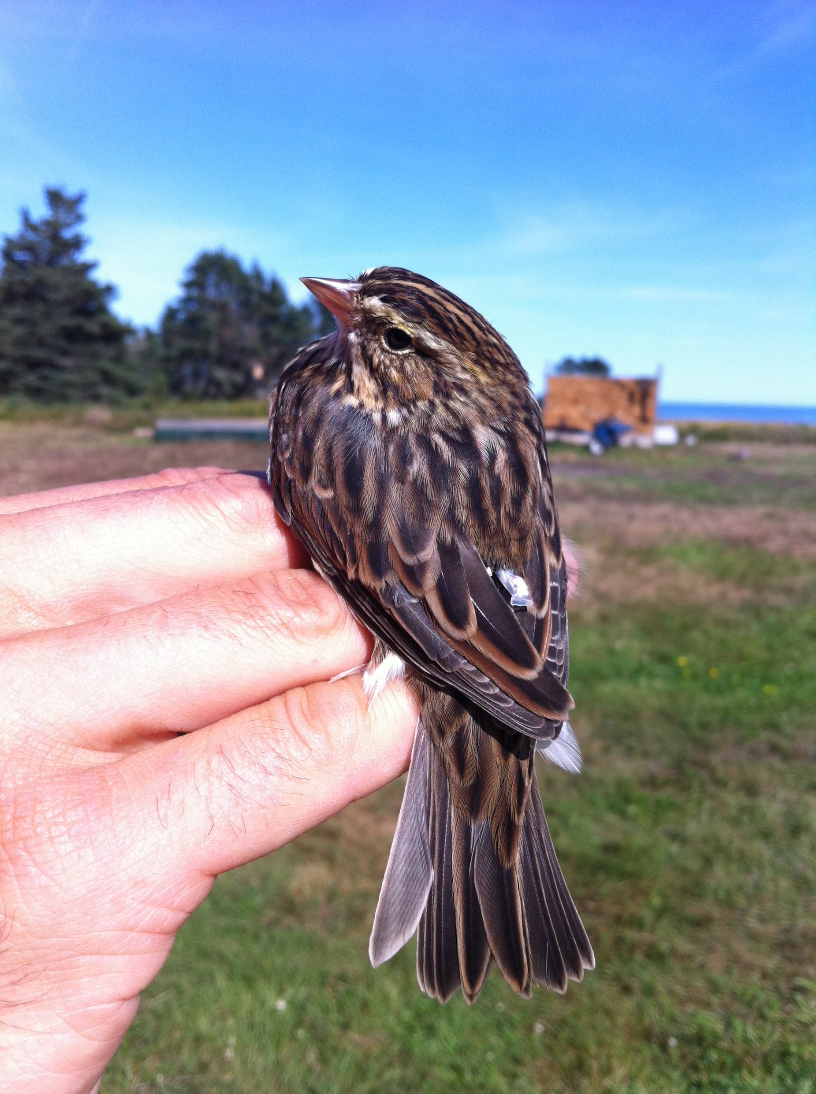

Yet another sampling scenario!!!
Research question: what is the winter distribution of savannah sparrows (NE USA)?
Grand Manon Is. (Can)
Kent Is. (USA)

Slide 8
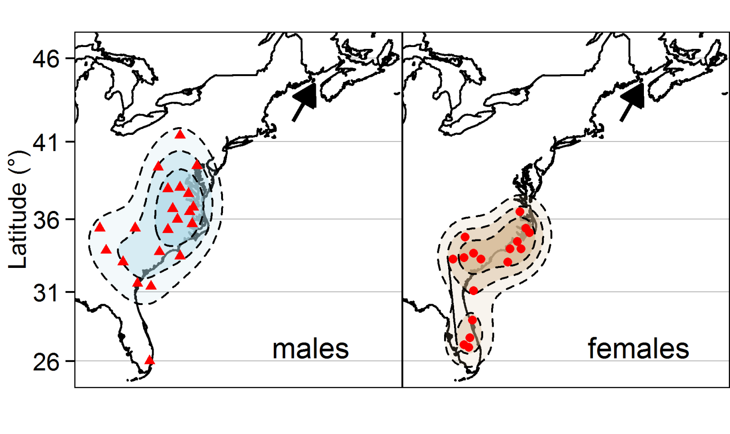
Yet another sampling scenario!!!
Research question: what is the winter distribution of savannah sparrows (NE USA)?
What if we only sampled females?

Slide 9
Sampling bias
Arises when sampling units in the population have an unequal chance of being observed or measured
may result in a sample that is not representative of the population

Slide 10
How do we randomise?
Common sampling approaches:
Simple random sampling
Stratified random sampling
Systematic sampling
Opportunistic, haphazard, or convenience sampling (I use this a lot when teaching in the field!)

Slide 11
Simple random sampling
All sampling units have equal chance of being sampled

Slide 12
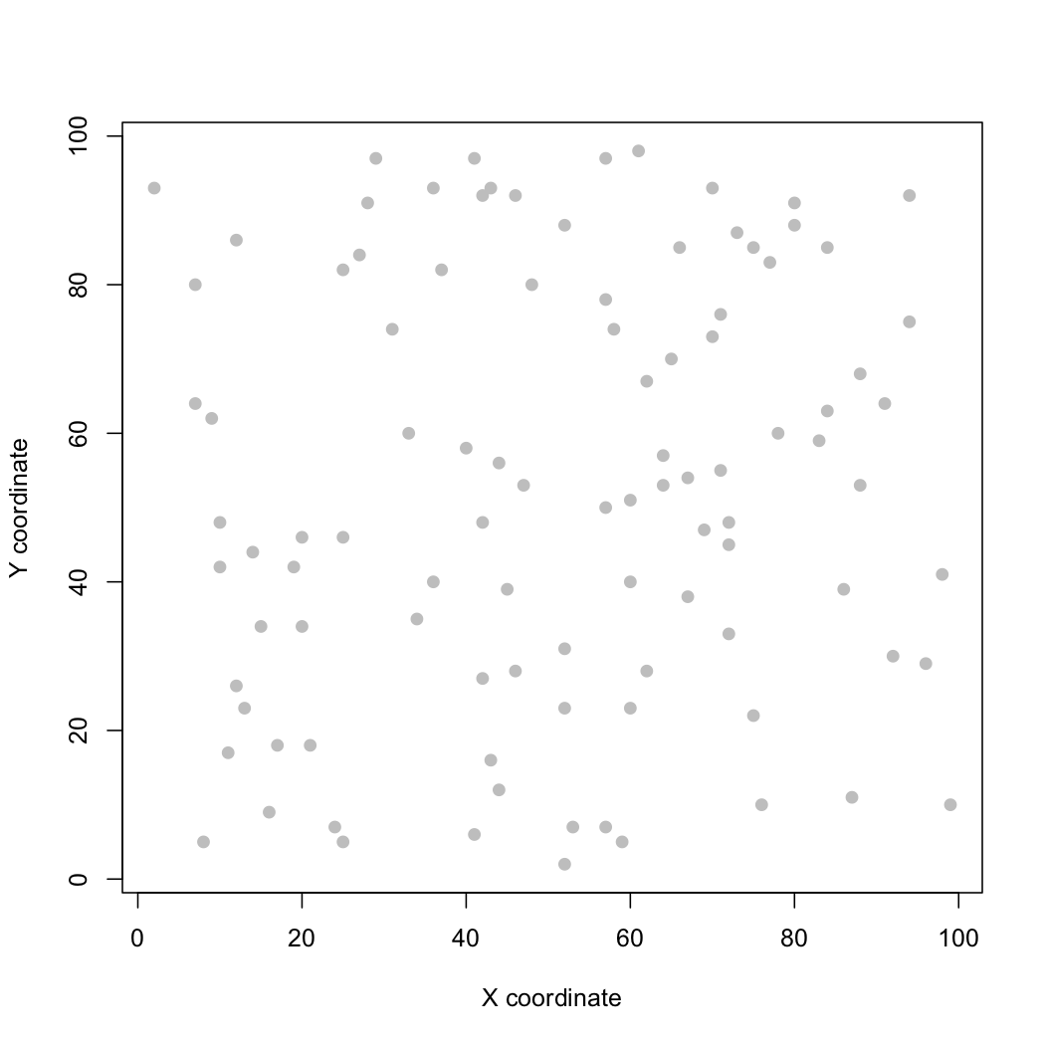

Slide 13
100 random samples

Slide 14
Simple random sampling
This gives unbiased parameter estimates
BUT IS OFTEN IMPRACTICAL!!!

Slide 15
Stratified random sampling
Can be used to capture important heterogeneity within populations
Sample randomly within pre-defined ‘strata’
E.g. take 33 random samples from each of 3 different habitat types

Slide 16
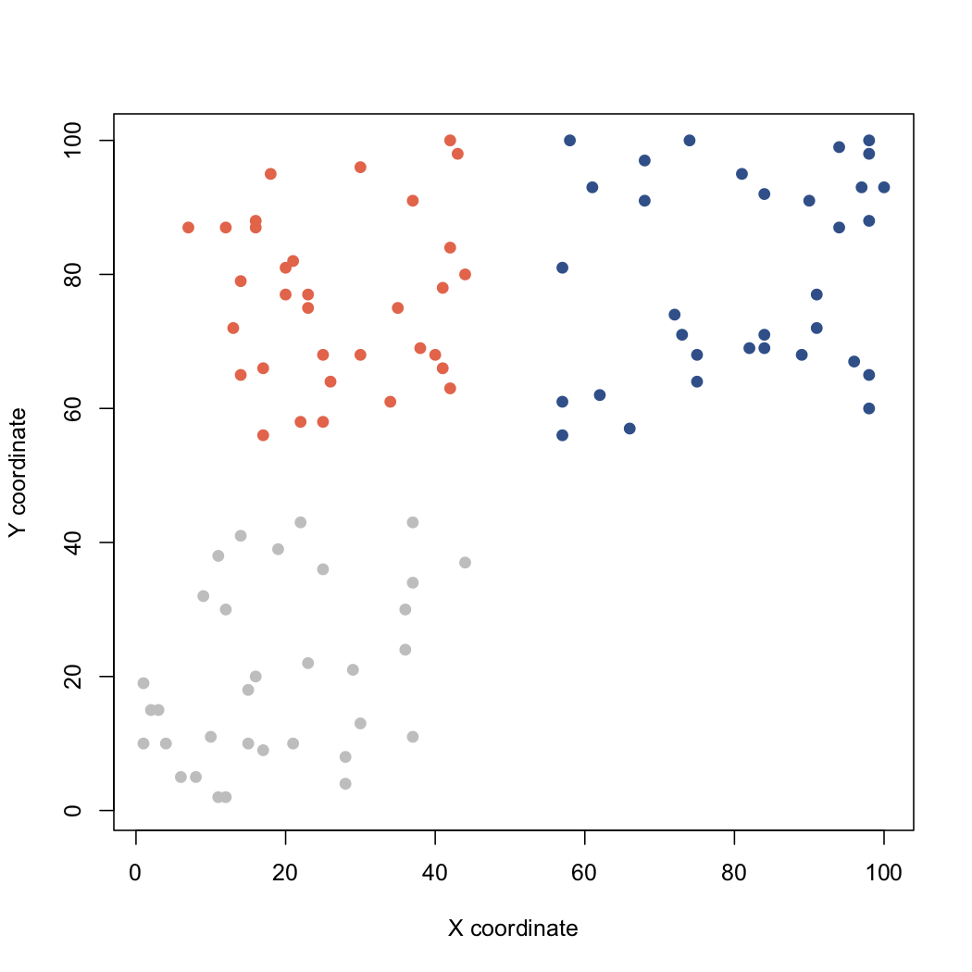
Habitat type A
Habitat type B
Unsuitable
habitat
Habitat type C

Slide 17
Habitat type A
Habitat type B
Proportional allocation of sampling effort (33 per habitat type)
Unsuitable
habitat
Habitat type C

Slide 18
Systematic sampling
Regular sampling intervals
Useful for identifying spatial patterns

Slide 19
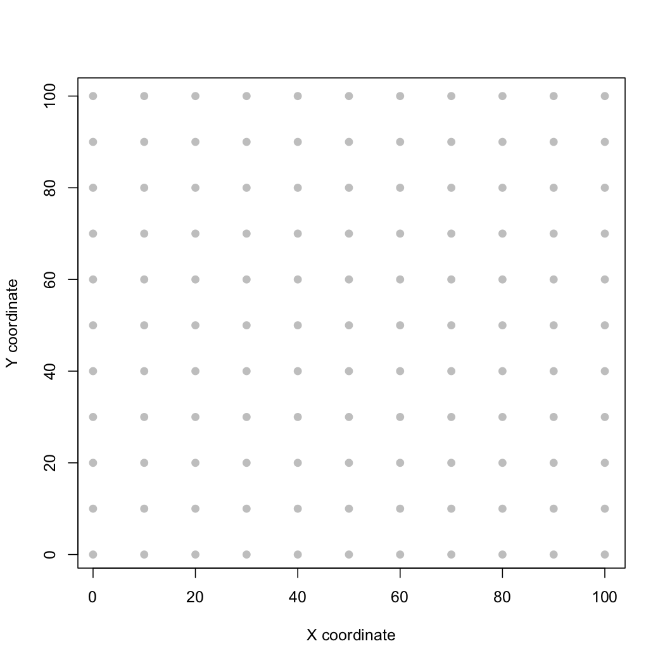

Slide 20
But beware!!!

Slide 21
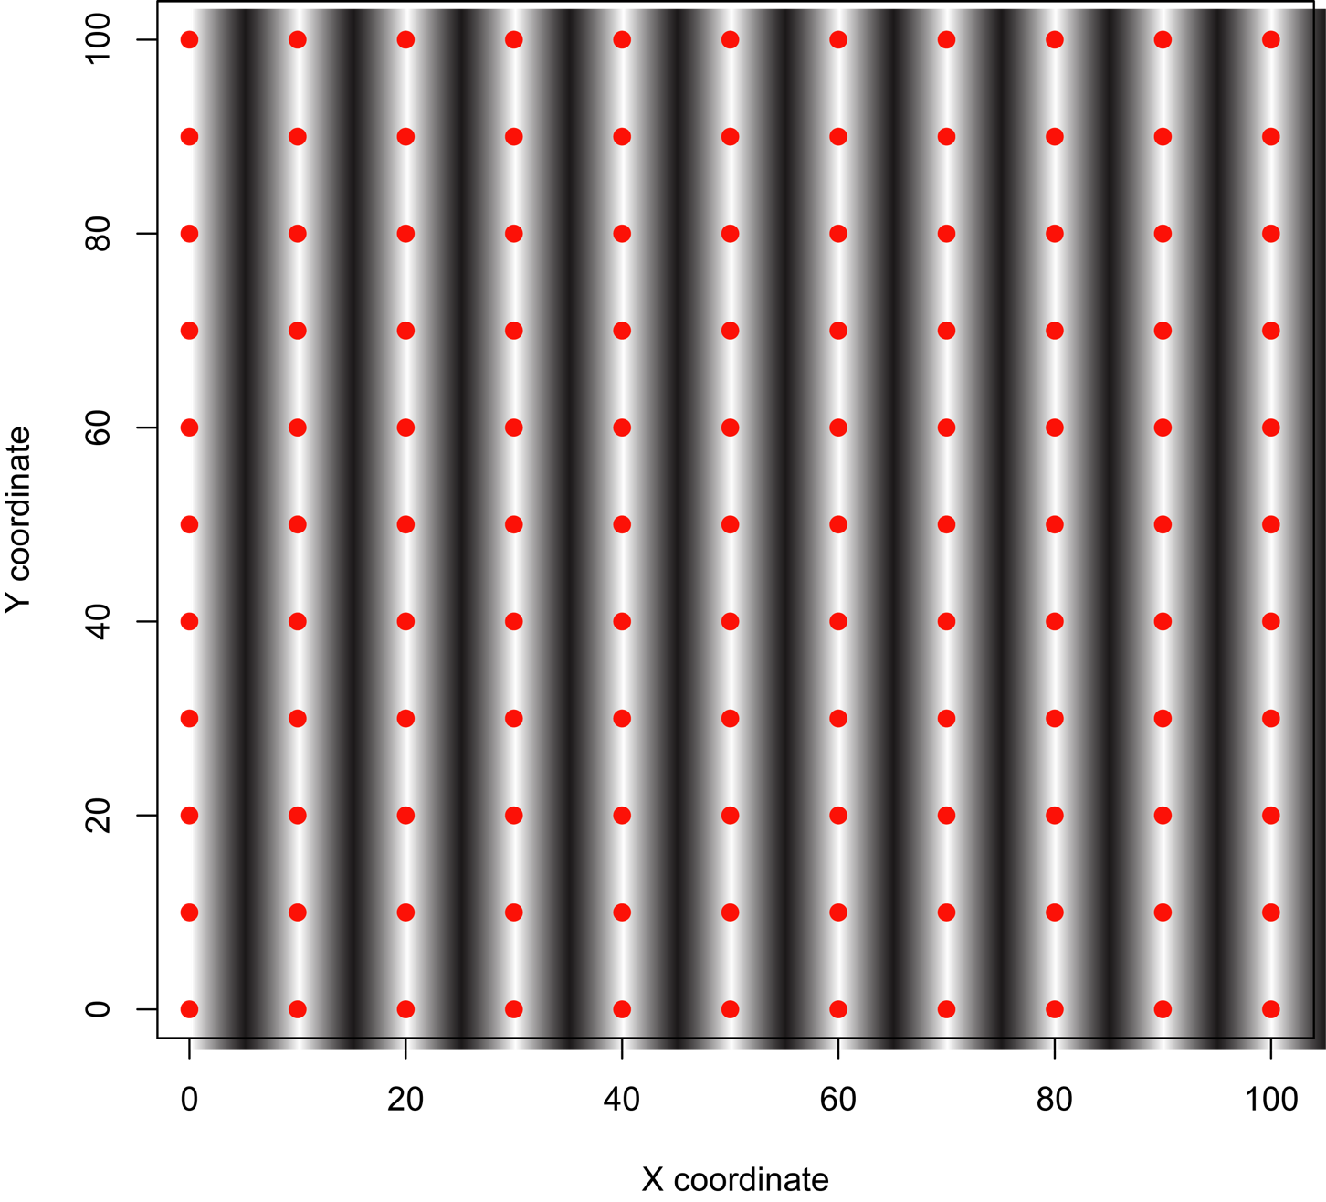

Slide 22

Risk of sampling interval coinciding with environmental pattern!!!

Slide 23
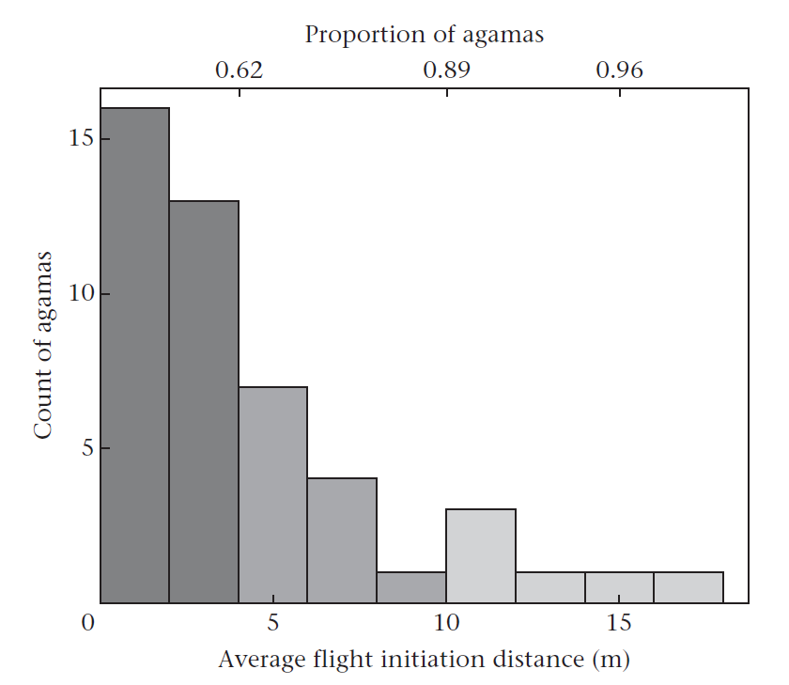
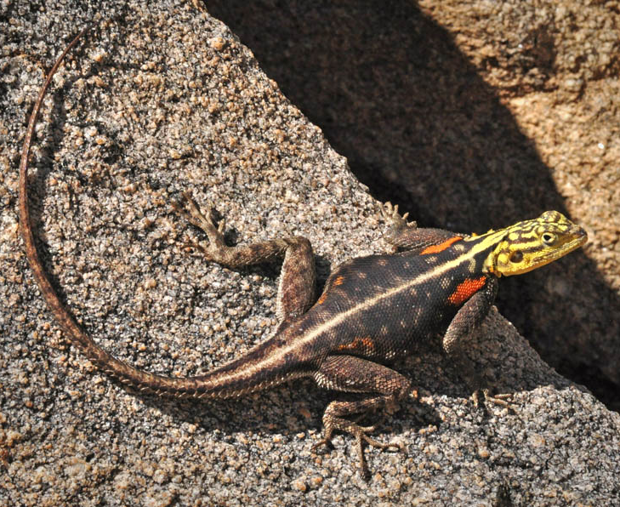
Other sources of bias
Animal behaviour!
Count of agamas
Namib rock agama
(Agama planiceps)
‘Skittishness’
Carter et al. 2012 Anim Behav

Slide 24
Other sources of bias
Animal behaviour!
Less skittish agamas are more likely to be caught with nooses!
Count of agamas
Namib rock agama
(Agama planiceps)
‘Skittishness’
Carter et al. 2012 Anim Behav

Slide 25
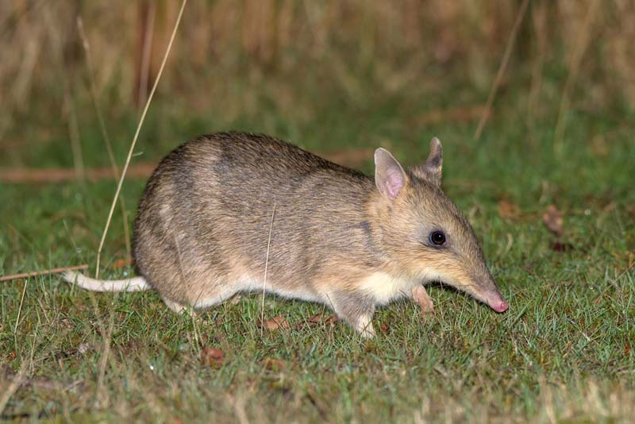
Other sources of bias
Trap happiness or trap shyness

Slide 26
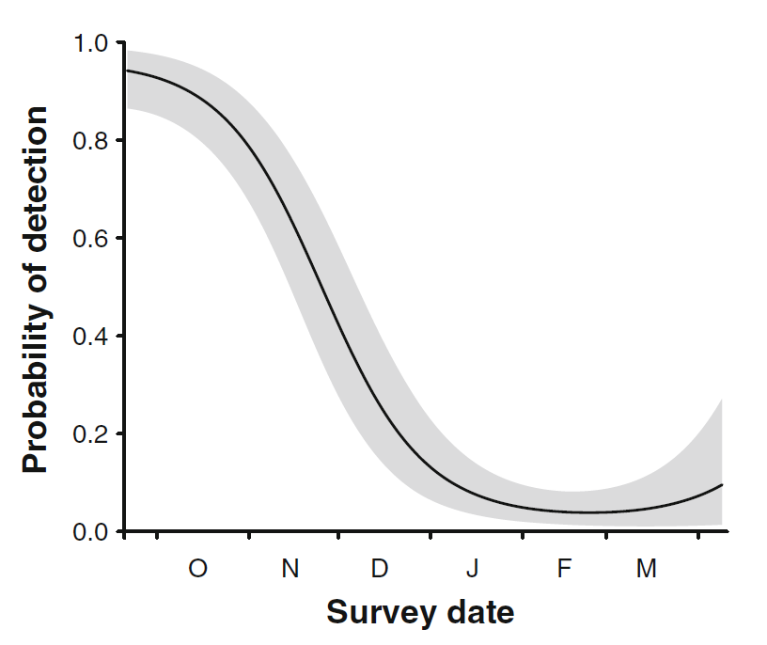
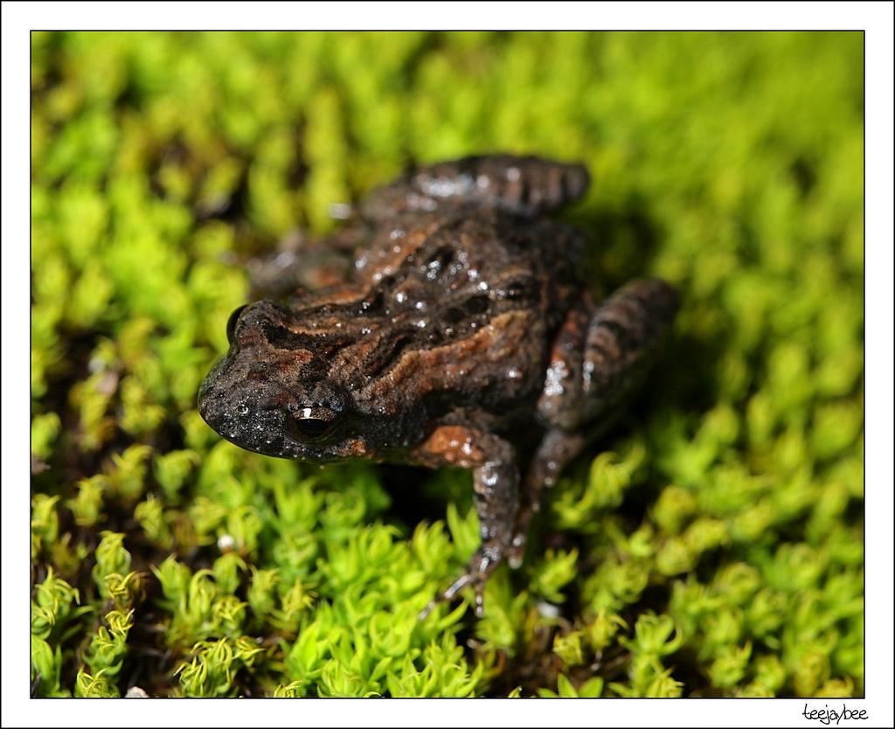
Other sources of bias
Temporal patterns in detectability
diurnal, seasonal
Common froglet (Crinia signifera)
Canessa et al. 2012 Biodivers Conserv

Slide 27
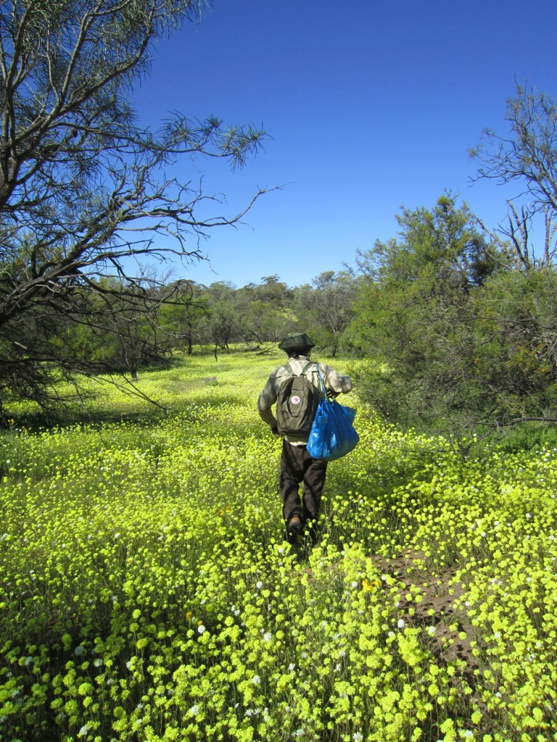
Other sources of bias
Temporal patterns in detectability
diurnal, seasonal

Slide 28
Haphazard / Convenience sampling
No probabilistic basis for where and when sampling occurs
Estimation of population parameters more complicated and requires more assumptions
Many uses, but limitations should be recognized

Slide 29
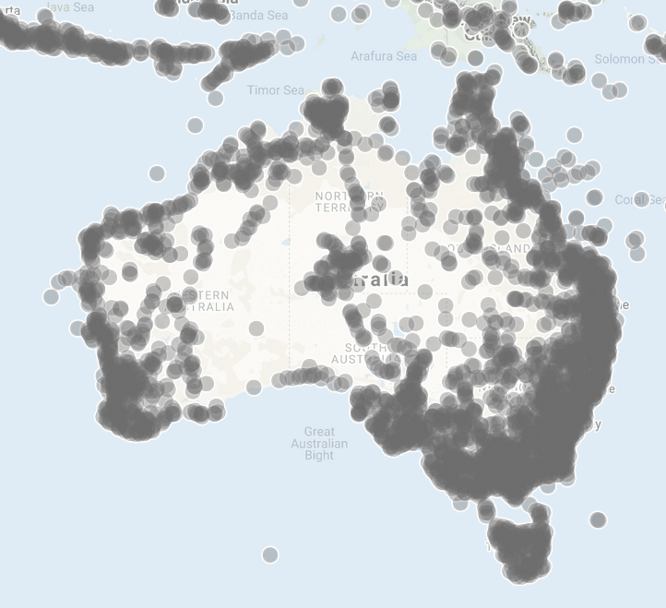

Haphazard / Convenience sampling

Slide 30
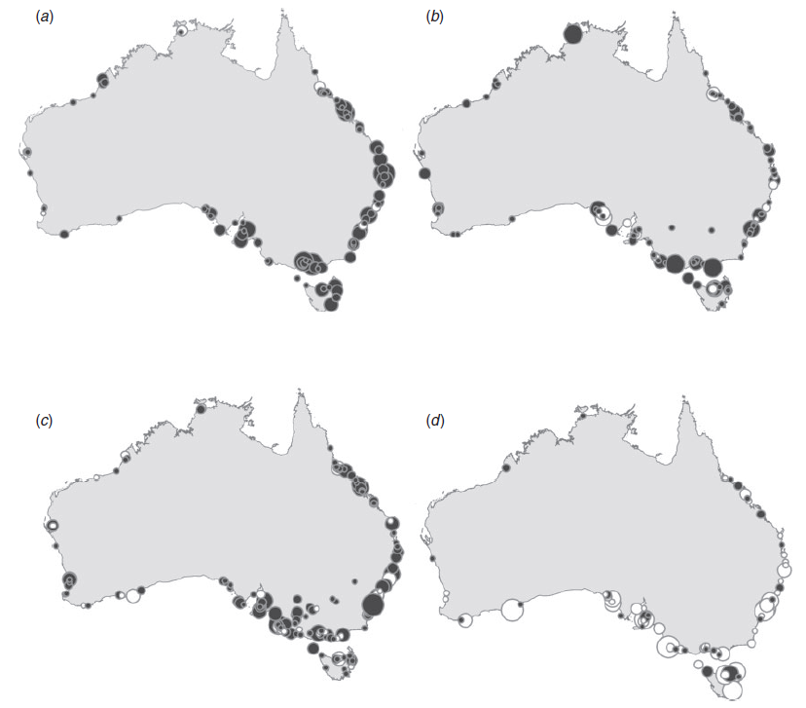
Haphazard / Convenience sampling
Gulf of Carpentaria hosts thousands of migratory shorebirds each year, but lacks consistent, long-term monitoring data
Clemens et al. 2016 Emu

Slide 31
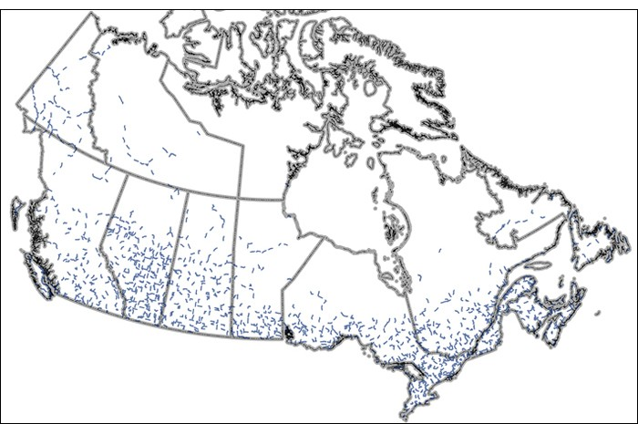
North American Breeding Bird Survey
“…data are collected by thousands of dedicated participants along thousands of roadside routes throughout the continent…population data and population trend analyses on more than 400 bird species…”
https://www.mbr-pwrc.usgs.gov/bbs/
https://wildlife-species.canada.ca/breeding-bird-survey-results/

Slide 32
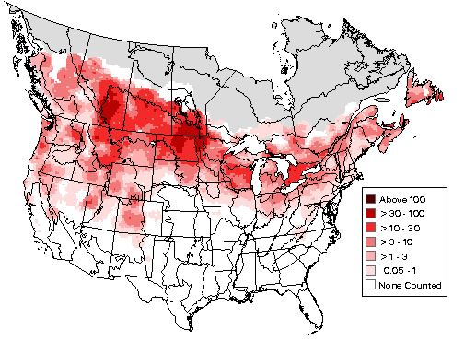
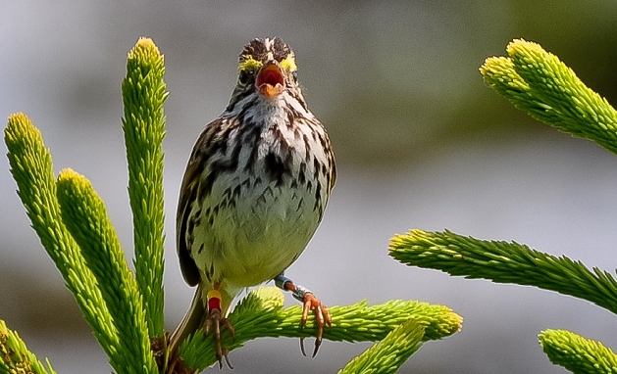
North American Breeding Bird Survey
https://www.mbr-pwrc.usgs.gov/bbs/
https://wildlife-species.canada.ca/breeding-bird-survey-results/

Slide 33
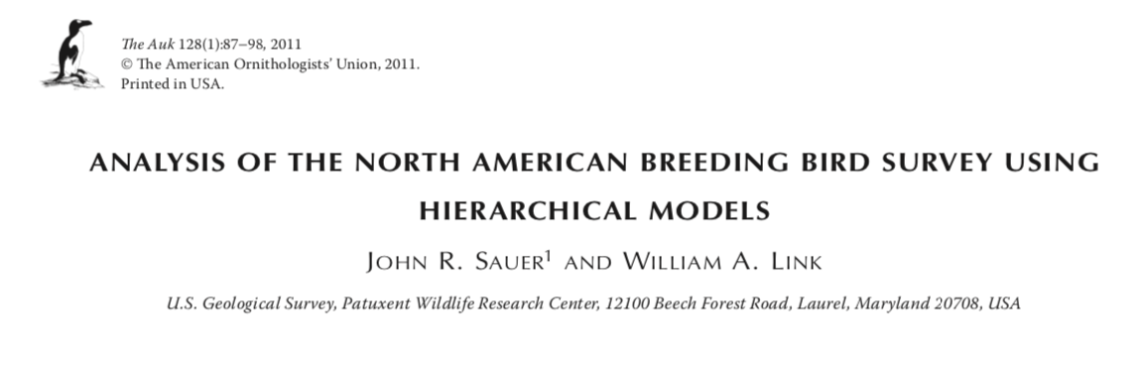
North American Breeding Bird Survey
Lots of sophisticated statistical approaches to estimate species’ trends that deal with sampling issues

Slide 34
Key points
Randomisation helps to protect against systematic (often hidden) sources of sampling bias
Barriers to randomisation: cost, accessibility, feasibility, knowledge, ethics
Many uses for data collected haphazardly, but limitations need to be recognized and appropriate methods implemented

Slide 35
Coming up
Thursday 1pm Workshop: Understanding interactions between categorical variables
Thursday 5pm Lecture (Rich Fuller): Earth observation
Pre-recorded stats lecture: Linear models (ANOVA)
Friday R Prac: Linear models (ANOVA)

